Slide 1
Dan Birman
2016-02-16
Frisem

Slide 2
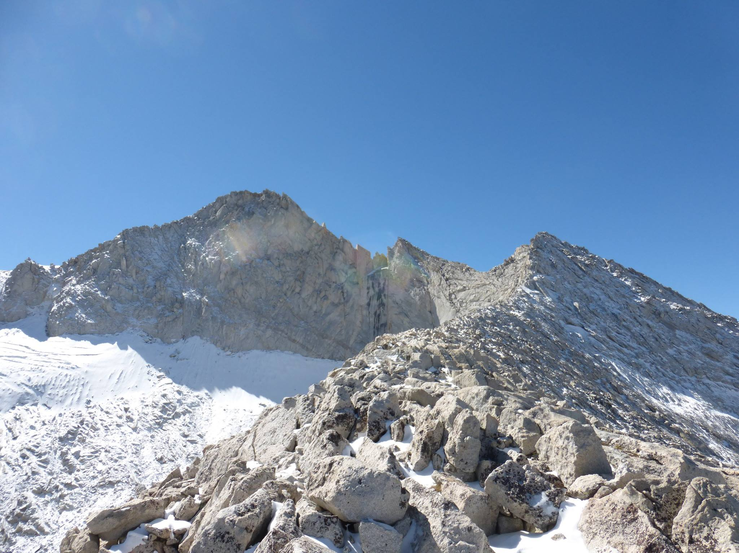

Slide 3
Add pictures of 5.15 game… for fun!
#five15game

Slide 4
Dan Birman
2016-02-16
Frisem

Slide 5
Using monkeys as models for humans…
Dan Birman
2016-02-16
Frisem

Slide 6
Using monkeys as models for humans…
And when that breaks down, using
humans as models for the monkeys…
Dan Birman
2016-02-16
Frisem

Slide 7
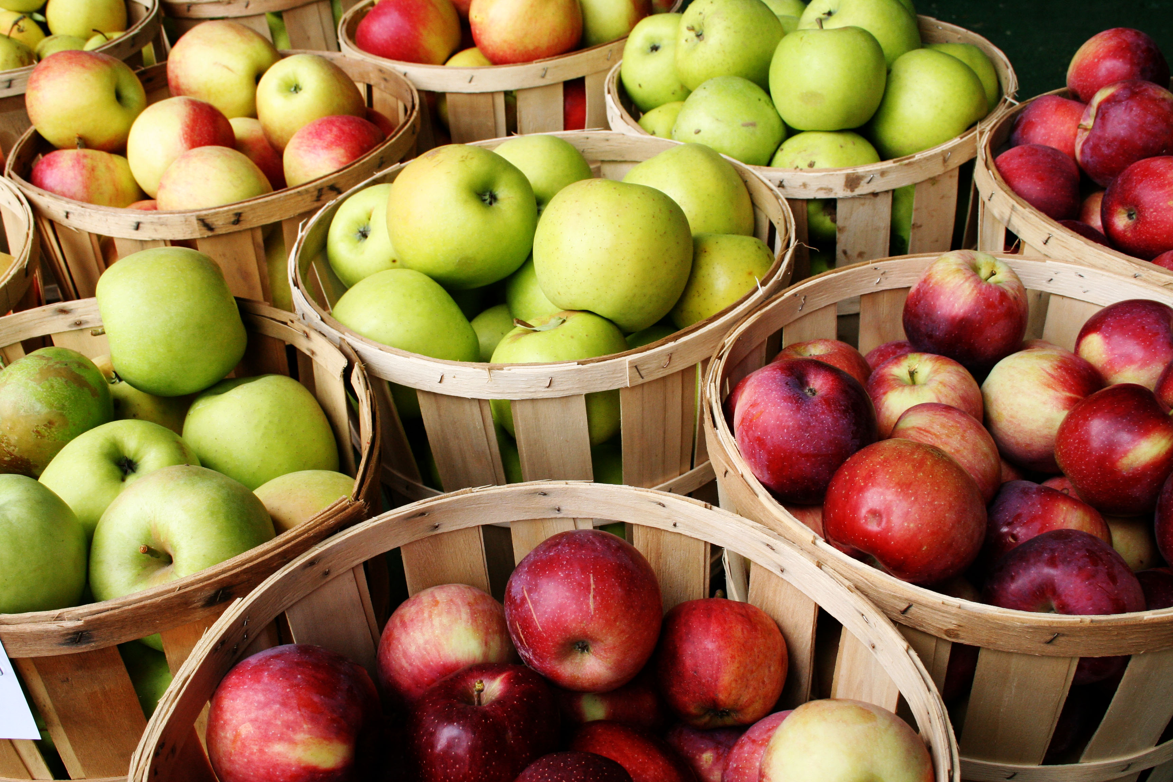

Slide 8
Color
Taste
Size

Slide 9
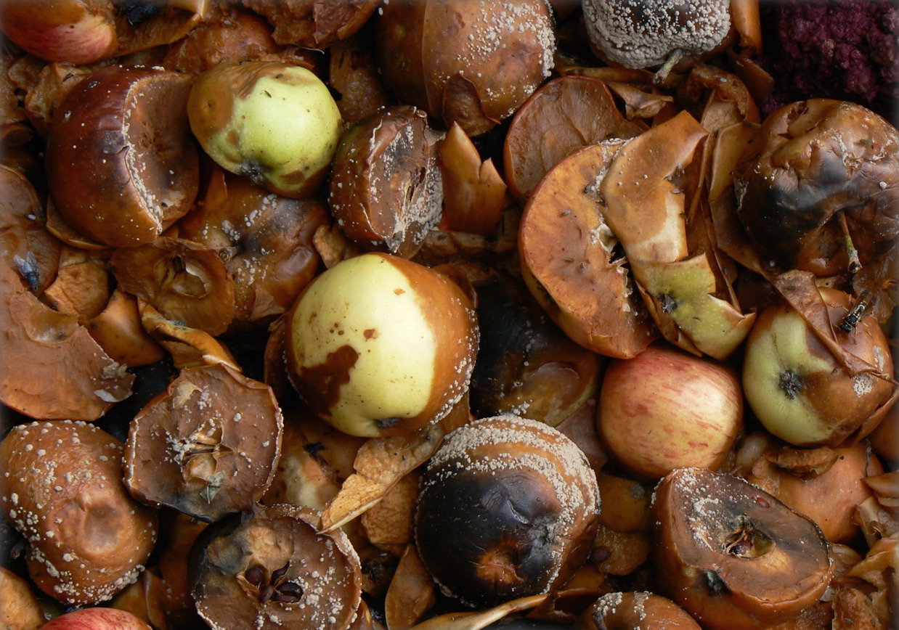
Rotten
Color
Healthy
Taste
Size

Slide 10
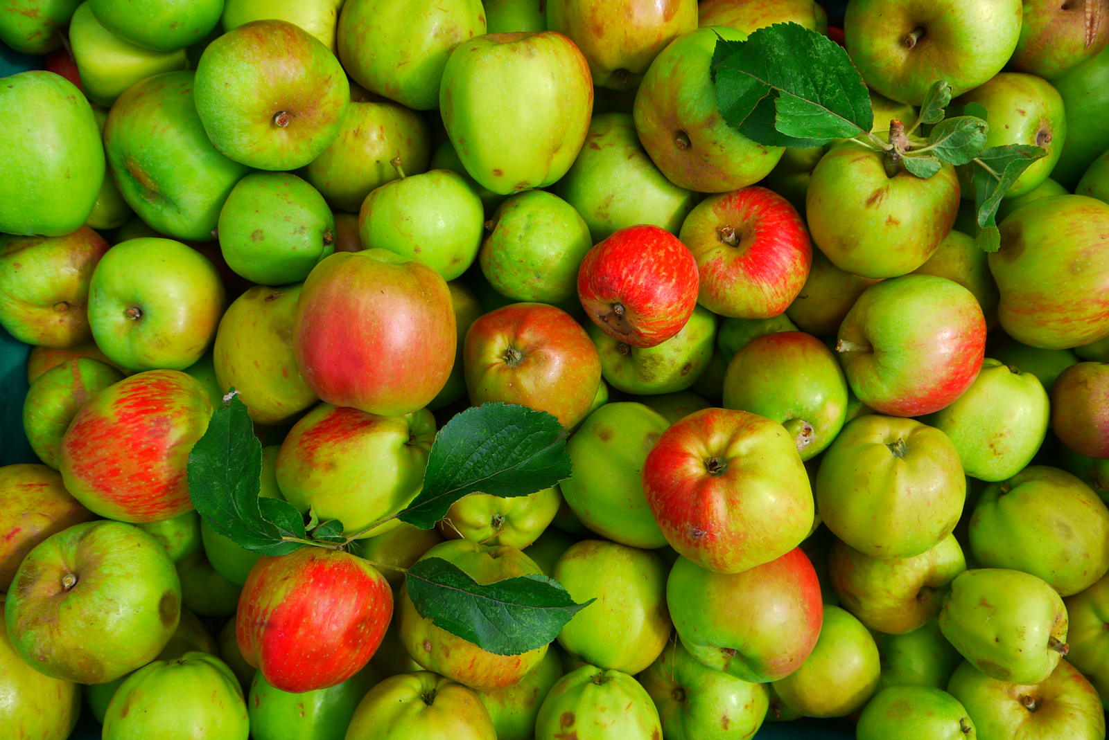
Notes:
Operationalized version of task!!

Slide 11
Freedman, D.J. & Assad, J.A. Nature 443, 85–88 (2006).
Sarma, A., Masse, N.Y., Wang, X.-J. & Freedman, D.J. Nat. Neurosci. 19, 143–149 (2016).
Categorization in monkeys

Slide 12
Operationalizing Categorization
What is it like to be a monkey doing categorization?
Rotten
Color
Healthy
Taste
Size

Slide 13
Demo Time!
Implicit learning tasks
Two stimuli: learn the rule!
Press – or don’t press

Slide 14
Demo Time!
stanford.io/24mI6IV
stanford.io/1QytfqA

Slide 15
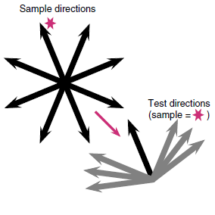

Slide 16
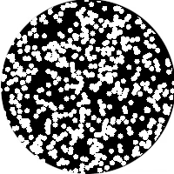

Slide 18
Sarma et al. 2016

Slide 19
Sarma et al. 2016

Slide 20
Sarma et al. 2016

Slide 21
Can you learn to categorize the way monkeys do?
Dms first
DMC second
Keep in mind these are implicit learning tasks
Both tasks are about abstract categories, but # of categories is different, and range of features
In the categories is different, hard to infer from behavior what they are doing

Slide 22
What about monkeys? What do they do
Obvious issue: monkeys might not pick up on the abstractions right away,
That’s okay they learn over time…
Except that they don’t.

Slide 23
DMS task, monkeys look really really different
Threshold demo
Monkeys aren’t bad at motion discrimination (neither are humans)
So why are they so bad at this?

Slide 24
DMC task—show that humans are not so good
Dichotomy 2x2 matrix: dms/dmc vs. hum/mon

Slide 25
We want to understand humans
What do we gain from monkey models if we don’t cleary understand
What the monkeys are doing
Can monkeys do matching? (skinner vs. chomsky, operant conditioning
Vs. matching)

Slide 26
What is it like to be a monkey?

Slide 27
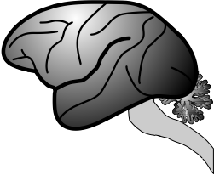
What is it like to be a monkey?

Slide 28
What is it like to be a monkey?

Slide 29
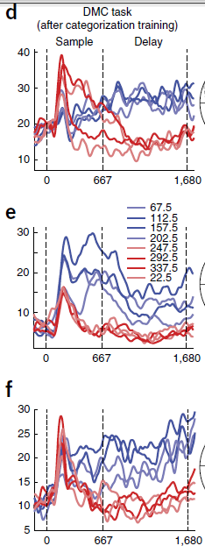
What is it like to be a monkey?

Slide 30
What is it like to be a monkey?

Slide 31
What is it like to be a monkey?

Slide 32
What is it like to be a monkey?
prospective student

Slide 33

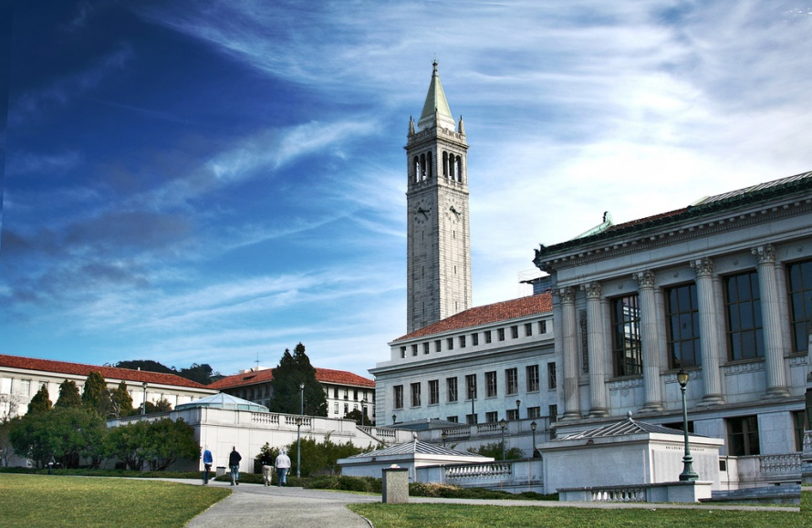

Slide 34
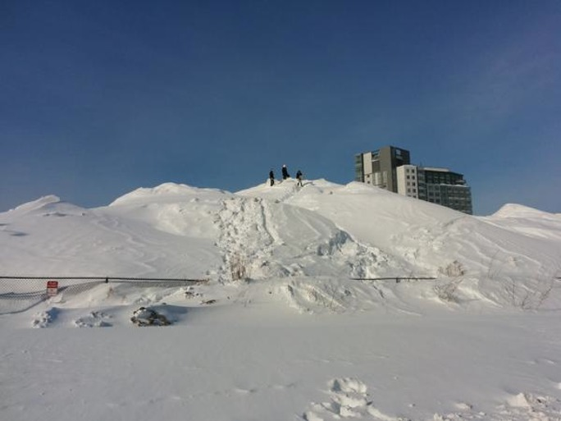

Slide 35
Criteria: Weather

Slide 36
Criteria: Weather
but also
Geography…

Slide 38
Criteria: # of Faculty

Slide 39
Criteria: In the US?

Slide 40




What is it like to be a monkey?
prospective student

Slide 41
What is it like to be a monkey?
prospective student

Slide 42
What is it like to be a monkey?
prospective student

Slide 43
What is it like to be a monkey?
prospective student

Slide 44
What is it like to be a monkey?
prospective student

Slide 45
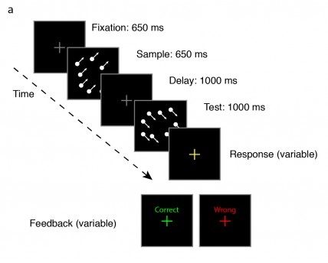

Slide 46
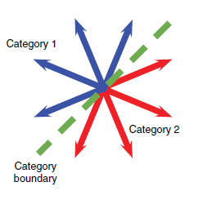

Slide 47
Categorization

Slide 48
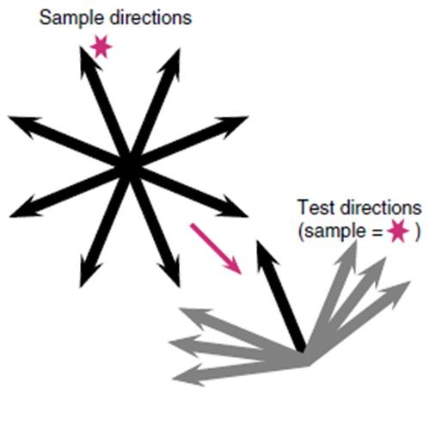
Categorization

Slide 49
Match to
Sample
Categorization

Slide 50
What is it like to be a monkey?

Slide 51
What is it like to be a …
monkey LIP neuron
doing categorization?

Slide 53


Arup Sarma, Nick Masse, X Wang, David Freedman @ U Chicago
David Freedman
Nick Masse

Slide 56
Sarma et al. 2016

Slide 61
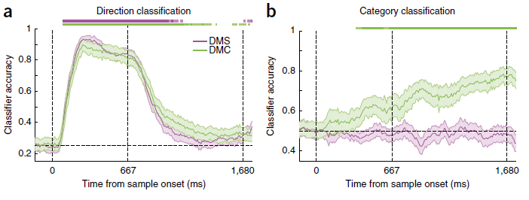

Slide 63
Sarma et al. 2016

Slide 64
What is it like to be a …
monkey LIP neuron
doing sample matching?

Slide 65
Sarma et al. 2016

Slide 66
Sarma et al. 2016

Slide 67
Sarma et al. 2016

Slide 68
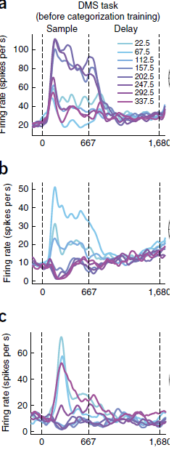

Slide 71

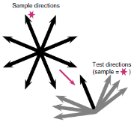
Match to Category
Match to Sample

Slide 72
What is it like to be a
monkey LIP neuron?

Slide 73
What is it like to be a
monkey LIP neuron?

Slide 74
What is it like to be a
monkey LIP neuron?

Slide 75


What is it like to be a
monkey LIP neuron?

Slide 76
What is it like to be a
monkey doing this task?

Slide 77
What is it like to be a
monkey doing this task?
human

Slide 78
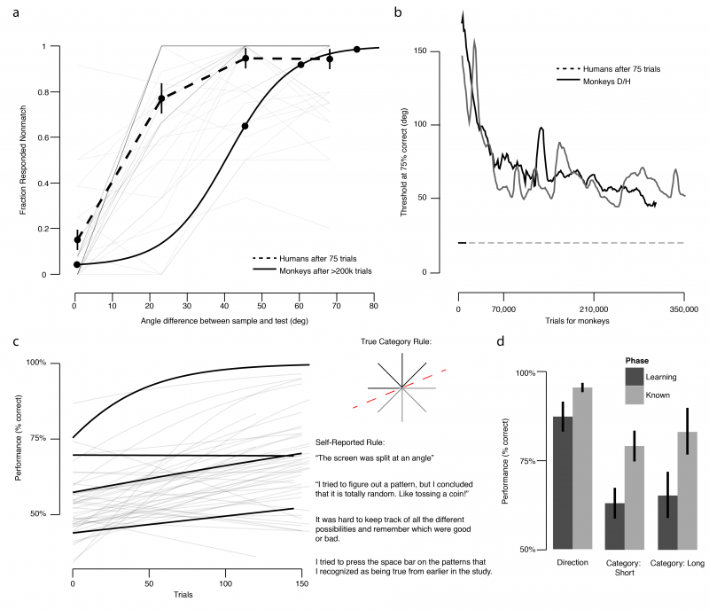

Slide 80
Threshold
~75% correct

Slide 90
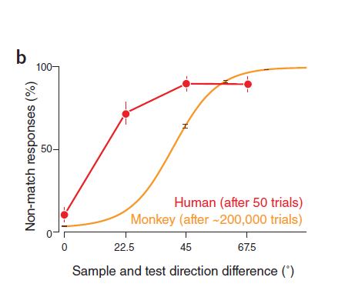
Birman & Gardner, Nat Neuro (2015)

Slide 91
Birman & Gardner, Nat Neuro (2015)

Slide 92
Birman & Gardner, Nat Neuro (2015)

Slide 93
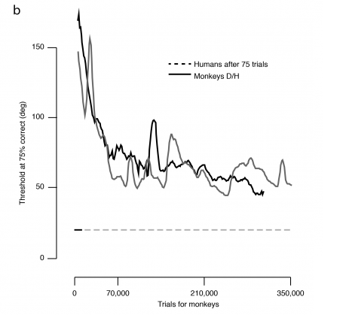

Slide 95
Human Performance (75 trials)

Slide 97
What is it like to be a
monkey doing this task?

Slide 98
What is it like to be a
monkey doing this task?

Slide 99
What is it like to be a
monkey doing this task?

Slide 100
What is it like to be a
monkey doing this task?

Slide 101
What is it like to be a
monkey doing this task?
Human behavioral data
can give us some insight…

Slide 102


Thank you!
Justin Gardner
Freedman Lab @ U Chicago
Nick Masse
David Freedman

